Slide 1

COVID-19 Cases Forecast
Dr. Nawana Coyle

Slide 2

Problem
Looking at the past data and the patterns, can we predict new cases and deaths associated with COVID-19 for the next 6 months?

Slide 3

Why It’s Important to Predict Incidents
According to WHO, there are over 455 millions of confirmed COVID-19 cases and 6.04 million related deaths in the world.
Forecasting help prepare for the future needs.
Brainstorm solutions to minimize the cases with the subject matter experts and authorities.
Educate the public on best practices ways to minimize cases.

Slide 4
Data for The Project
Original data for this project came from Johns Hopkins Center for Systems Science and Engineering page in GitHub at https://github.com/CSSEGISandData/COVID-19/tree/master/csse_covid_19_data/csse_covid_19_time_series

Slide 5
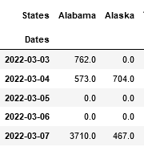

Data Cleaning and Processing
5 different files:
Confirmed cases in the US US.
Deaths in the US
Confirmed Cases Globally
Deaths in the US
Recovered in the US
Dropped unnecessary columns → for easy data processing
Renamed columns → for easier access
Calculated case totals by the state →understand the patterns
Formatted the date column → Apply models
Created separate monthly and yearly datasets
Using .dff() function, isolated the daily occurrences, instead of, up to date occurrences.

Slide 6
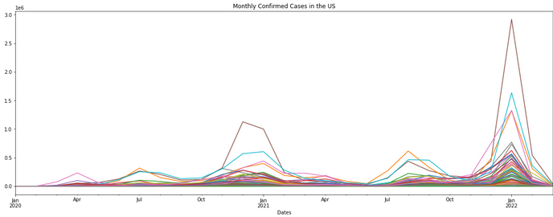
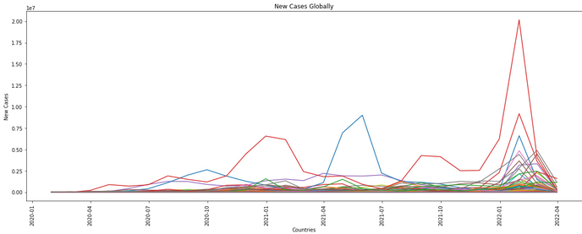

Exploratory Data Analysis (EDA)
Observation:
Dec, Jan → highest confirmed cases → US and Globally
Spike in winter 2021> 2020 both in the US and globally
Explanation:
People gather more due to holidays?
More testing done during holidays?
Both?

Slide 7
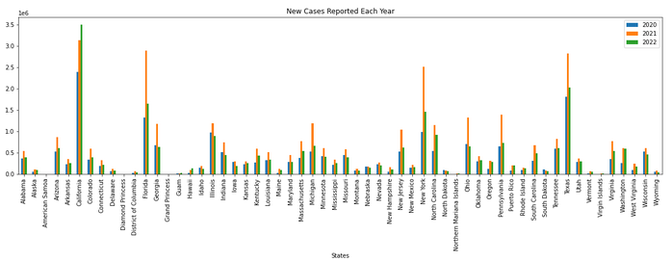

New Cases in The US Each Year (EDA)
Confirmed cases US in 2021 >2020
1. Not a true representation ?
2. No tests were available at the beginning of the pandemic?
3. 2021 had a different variant with higher transmissibility?
4. All?

Slide 8
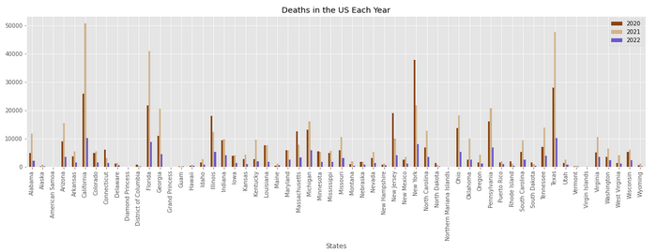
Deaths in The US Each Year (EDA)
Deaths caused in the US in 2021 >2020
Confirmed cases in many states, especially in CA by march 2022 is already higher than that of 2021 , but low death rate
A new variant with high transmissibility and low mortality rate?
OR not a data collection error?

Slide 9
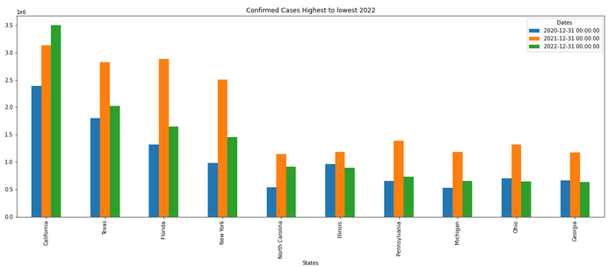
10 States with The Highest Number of New Cases in the US (EDA)
CA has the highest confirmed cases, followed by TX and FL respectively, which aligns with the order of population in each state .

Slide 10
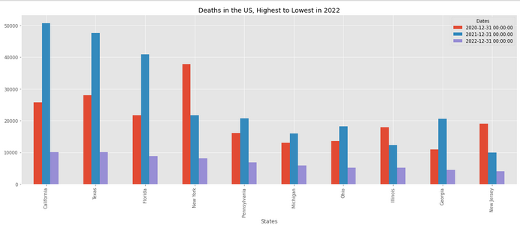
10 States with The Highest Number of Deaths in the US (EDA)
NY has the 4th highest population and confirmed cases in the US in 2021; yet surprisingly low death rates in 2021, especially given that fact NY had the highest deaths in the entire nation in 2020.
How did that happen?
Does NY has an extra cautious population? OR
Is it a result of an inaccurate data reporting?

Slide 11
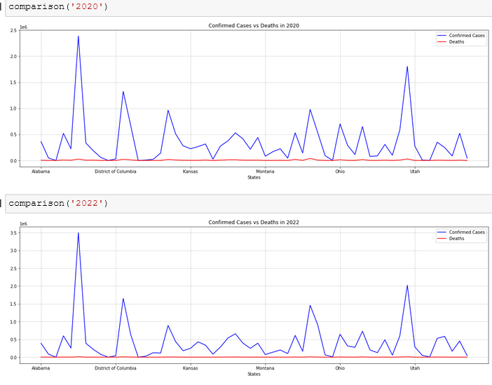
Pattern of New Cases in the US (EDA)
Comparison of new cases in the US, 2020 vs 2022
Number of confirmed cases throughout have a similar pattern year to year in each state.

Slide 12
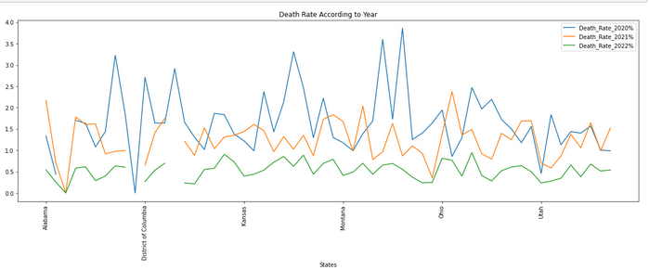
Death Rate in The Last 3 Yrs (EDA)
Overall, death rate throughout the country declined each year.
How ? → Change in virus variance and its mortality ?
Better upstanding of the virus and management of patient care ?
All?

Slide 13
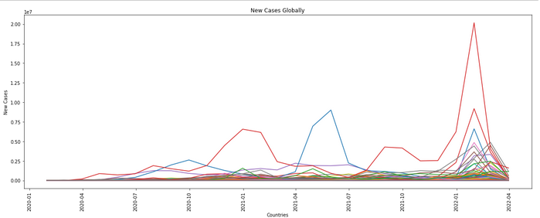
Confirmed Cases – Global (EDA)
Similar to the US, the confirmed cases around the world peaked in December and January of the following year.

Slide 14
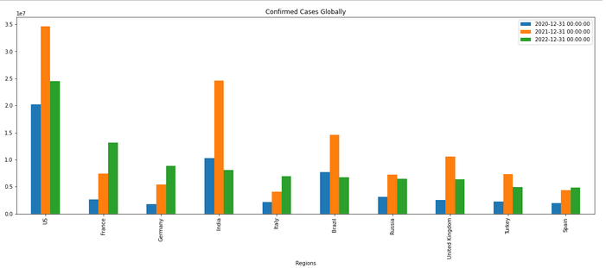
Confirmed Cases – Global (EDA)
Despite India and China having higher populations than the US, US still recorded highest number of confirmed cases
Why? → Inaccurate reporting? OR
Not having test kits in the other countries?

Slide 15
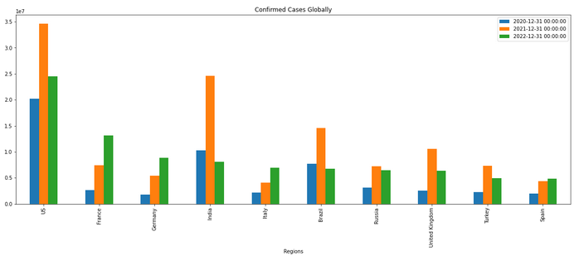
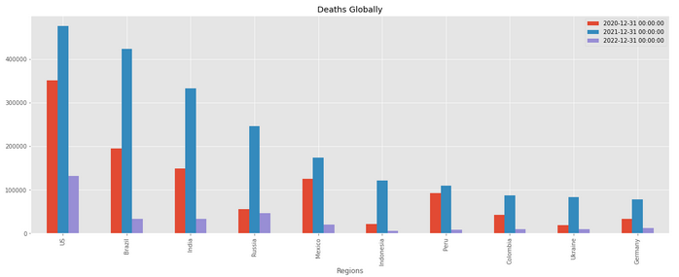
Confirmed Cases VS Deaths – Global (EDA)
World Population in 2022,
China > India > US
Confirmed cases in 2022,
US > France > Germany > India >Italy
Deaths in 2022,
US > Russia > India > Brazil > Mexico
Why are the confirmed cases and deaths do not align with world populations in general? Better patient care ? OR Inaccurate tracking?

Slide 16
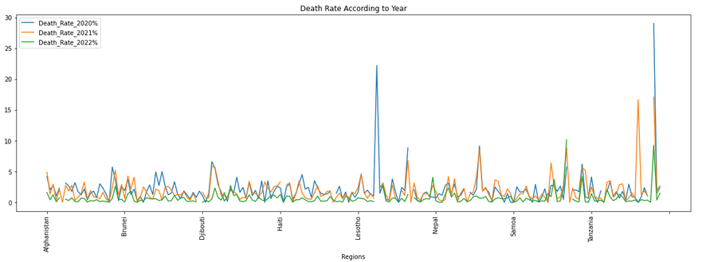
Global Death Rate in The Last 3 Yrs
Global death rate have come down over the last 3 years.
Even though total number of deaths in almost every country was higher in 2021 compared to 2020, the death rate in 2021 have come down significantly in certain regions.

Slide 17

Data Modeling
Understanding the trends and patterns of new cases and help educate the general public, and have necessary supplies and equipment for the healthcare facilities.
This is a project involving time forecasting future using prior data.
Models used for the project:
1. ARIMA model – Autoregressive Integrated Moving Average
2. SARIMA model – Seasonal ARIMA

Slide 18
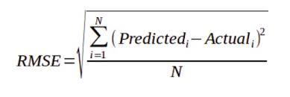
Data Modeling
Success of the project: → Lowest RMSE (root mean square error)
“A low RMSE value indicates that the simulated and observed data are close to each other showing a better accuracy”

Slide 19
Why Choose ARIMA Model
Works with data on a time frame.
Auto regression : Looks at data from past periods, p, when making predictions
Moving average : Future predictions are also made looking at the errors of the prior values, q.
Integration of past values and errors of prior values, d.

Slide 20
Why Choose SARIMA Model
SARIMA - an extension of ARIMA.
It explicitly supports univariate time series data with a seasonal component.
ARIMA does not support seasonal data, SARIMA does.
Auto regression : Looks at data from past periods, p, when making predictions
Moving average : Future predictions are also made looking at the errors of the prior values, q.
Integration of past values and errors of prior values, d.
s

Slide 21
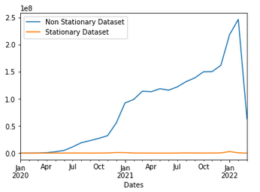

Implementing ARIMA
Checking for Stationary and Non Stationary Data
Data showing cases of just individual months – stationary
Showing data up to a specific month - non-stationary
the value obtained through the Dicky Fuller test confirms this.
Value < 0.05 is stationary

Slide 22
Implementing ARIMA
Goal: Find the best p, d, q order which gives the lowest RMSE.
1. Split data to train (70% of total data), test (30% of total data) datasets.
2. Give a range of value combinations for p, d, q and try different combinations using itertools .
p = np.arange(0,8)
d = np.arange(0,2)
q = np.arange(0,8)
Pdq_combos = list(itertools.product(p,d,q))
3. Try each p,d,q combination and save the RMSE associated with each combination to a file.
rmse = np.sqrt(mean_squared_error(test_data, predictions)

Slide 23
Turning ARIMA Continues
4. Find the order with the lowest RMSE
results[‘RMSE’].idxmin(), results[‘RMSE’].min()
5. Training the data using the order for p,d,q which gives the lowest RMSE.
model = ARIMA(train_data, order = p,d,q).fit()
6. Make predictions using this new model with the parameters
predictions = model.predict(start = .., end = ..)
7. Visualize the training data, test data and predictions in a plot.

Slide 24
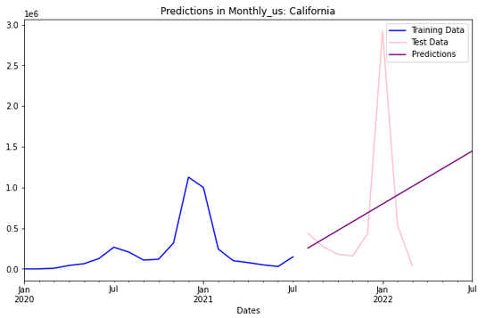
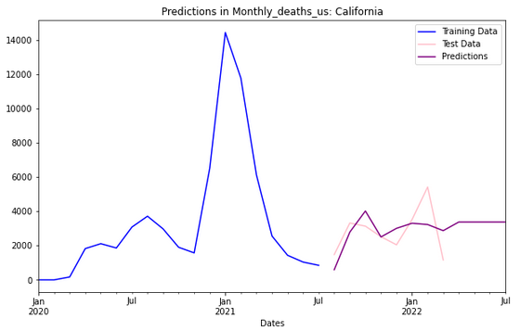
Results of ARIMA Model
Order = (1, 2, 0)
The predictions are done on monthly confirmed cases in California.
Order = (0, 0, 8)
Predictions are done on monthly deaths in California.
Predictions made on US deaths for the 3 months into the future is more accurate than the new cases for the next 3 months.

Slide 25
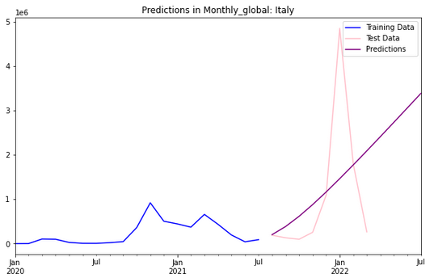
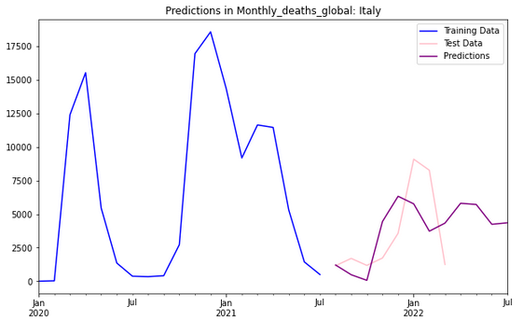
Results of ARIMA Model
Order = (1, 2, 4)
The predictions are done on monthly confirmed cases in Italy.
Order = (3, 1, 7)
Predictions are done on monthly deaths in Italy.
Similar to the predictions made on US, global deaths for the 3 months into the future is more accurate than the new cases for the next 3 months.

Slide 26
Evaluating The Model

Slide 27
Evaluating The Model

Slide 28
Evaluating The Model

Slide 29
SARIMA Model
Works with data on a time frame.
Auto regression : Looks at data from past periods, p, when making predictions
Moving average : Future predictions are also made looking at the errors of the prior values, q.
Integration of past values and errors of prior values, d.

Slide 30
Why Choose ARIMA Model
p = [0,1,2,3,4,5,6,7,8]
d = [0,1,2]
q = [0,1,2,3,4,5,6,7,8]
import itertools
pdq_combinations = list(itertools.product(p, d, q))
pdqs = []
rmse = []
# Since we're looking for one state at a time, we choose CA, since it had the highest number of confirmed cases and deaths.
for pdq in pdq_combinations:
try:
model = ARIMA(train_dUS['California'], order = pdq).fit()
pred = model.predict(start = len(train_dUS), end = (len(daily_US)-1))
error = np.sqrt(mean_squared_error(test_dUS['California'], pred))
pdqs.append(pdq)
rmse.append(error)
except:
continue

Slide 31
Summary of The Project
Problem
Looking at given clinical data, can we predict who will develop heart disease?
Findings
According to data, significantly more women with heart disease compared to men – Could this be true in the real world?
According to data, there’s no significant effect of fasting blood sugar on developing heart disease. – Could this be true in the real world?
According to data, many people with exercise induced angina do not develop heart disease – Could this be true in the real world?
High blood pressure and high cholesterol levels have no significant effect on developing heart disease - – Could this be true in the real world?
Results
Logistic regression made the best predictions, compared to other models.
The highest accuracy score reached was 88.52% even though the target was 95%.
Cross validation provided better recall results, which was indicative that number of false negative values were reduced.
Feature importance showed that certain attributes had a positive correlation while the others had a negative correlation.

Slide 32
Areas of Improvement

Slide 33
Thank you!

